Slide 1
Weighted Correlation Network Analysis and Systems Biologic Applications

Slide 2
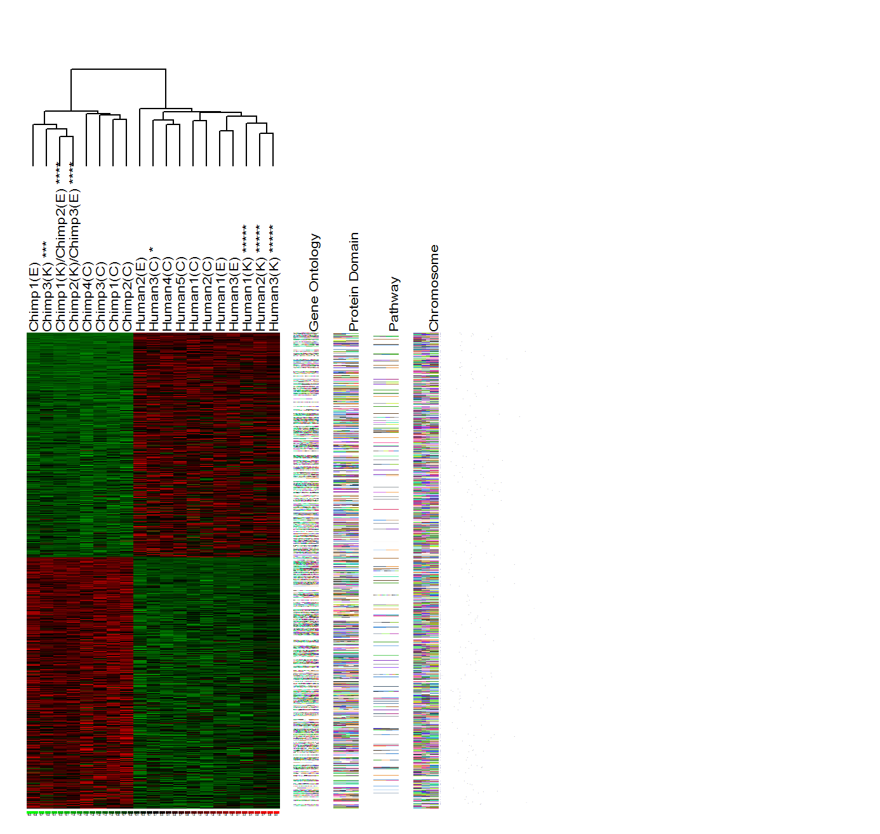
Standard differential expression analyses seek to identify individual genes
Control
Experimental
Each gene is treated as an individual entity
Often misses the forest for the trees: Fails to recognize that thousands of genes can be organized into relatively few modules

Slide 3
Philosophy of Weighted Gene Co-Expression Network Analysis
Understand the “system” instead of reporting a list of individual parts
Describe the functioning of the engine instead of enumerating individual nuts and bolts
Focus on modules as opposed to individual genes
this greatly alleviates multiple testing problem
Network terminology is intuitive to biologists

Slide 4
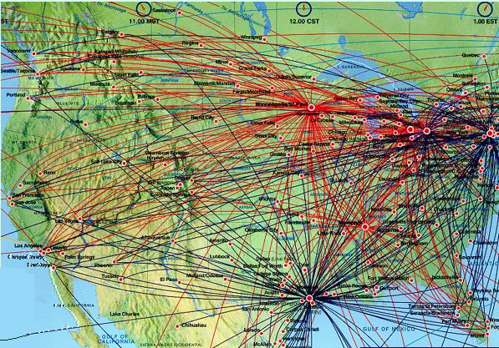
Flight connections and hub airports
The nodes with the largest number of links (connections) are most important!
**Slide courtesy of AL Barabasi

Slide 5
Contents
How to construct a weighted gene co-expression network?
Why use soft thresholding?
How to detect network modules?
How to relate modules to an external clinical trait?
What is intramodular connectivity?
How to use networks for gene screening?
How to integrate networks with genetic marker data?
What is weighted gene co-expression network analysis (WGCNA)?

Slide 6
Standard differential expression analyses seek to identify individual genes
Control
Experimental
Each gene is treated as an individual entity
Often misses the forest for the trees: Fails to recognize that thousands of genes can be organized into relatively few modules

Slide 7
Philosophy of Weighted Gene Co-Expression Network Analysis
Understand the “system” instead of reporting a list of individual parts
Describe the functioning of the engine instead of enumerating individual nuts and bolts
Focus on modules as opposed to individual genes
this greatly alleviates multiple testing problem
Network terminology is intuitive to biologists

Slide 8
What is weighted gene co-expression network analysis?

Slide 9
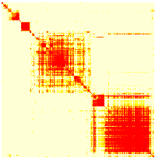
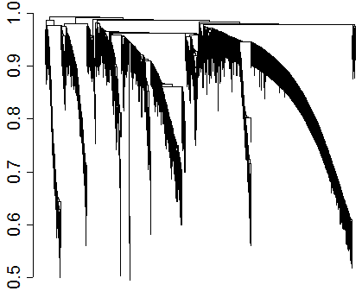
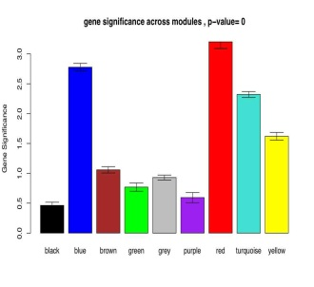
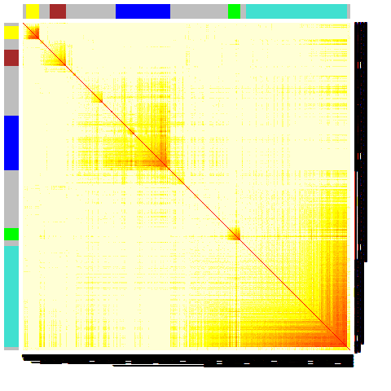
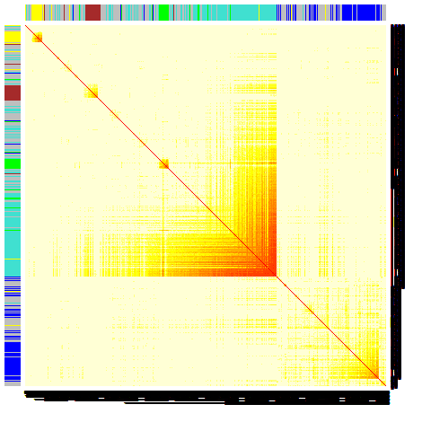
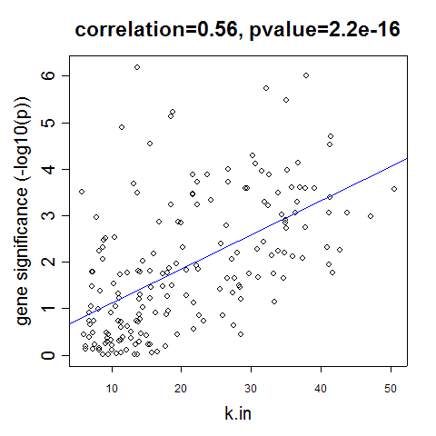
Construct a network
Rationale: make use of interaction patterns between genes
Identify modules
Rationale: module (pathway) based analysis
Relate modules to external information
Array Information: Clinical data, SNPs, proteomics
Gene Information: gene ontology, EASE, IPA
Rationale: find biologically interesting modules
Study Module Preservation across different data
Rationale:
Same data: to check robustness of module definition
Different data: to find interesting modules.
Find the key drivers in interesting modules
Tools: intramodular connectivity, causality testing
Rationale: experimental validation, therapeutics, biomarkers

Slide 10
Weighted correlation networks are valuable for a biologically meaningful…
reduction of high dimensional data
expression: microarray, RNA-seq
gene methylation data, fMRI data, etc.
integration of multiscale data:
expression data from multiple tissues
SNPs (module QTL analysis)
Complex phenotypes

Slide 11
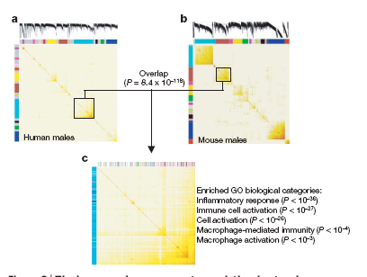

Slide 12
How to construct a weighted gene co-expression network? Bin Zhang and Steve Horvath (2005) "A General Framework for Weighted Gene Co-Expression Network Analysis", Statistical Applications in Genetics and Molecular Biology: Vol. 4: No. 1, Article 17.

Slide 13
Network=Adjacency Matrix
A network can be represented by an adjacency matrix, A=[a_{ij}], that encodes whether/how a pair of nodes is connected.
A is a symmetric matrix with entries in [0,1]
For unweighted network, entries are 1 or 0 depending on whether or not 2 nodes are adjacent (connected)
For weighted networks, the adjacency matrix reports the connection strength between gene pairs

Slide 14
Steps for constructing a co-expression network
Overview: gene co-expression network analysis
Gene expression data (array or RNA-seq)
Measure co-expression with a correlation coefficient
C) The correlation matrix is either dichotomized to arrive at an adjacency matrix → unweighted network
Or transformed continuously with the power adjacency function → weighted network

Slide 15
The `holistic’ view of a weighted network
Weighted Network View Unweighted View
All genes are connected Some genes are connected
Connection Widths=Connection strenghts All connections are equal
Hard thresholding may lead to an information loss.
If two genes are correlated with r=0.79, they are deemed unconnected
with regard to a hard threshold of tau=0.8

Slide 16
Two types of weighted correlation networks
Default values: β=6 for unsigned and β =12 for signed networks.
We prefer signed networks…
Zhang et al SAGMB Vol. 4: No. 1, Article 17.

Slide 17
Adjacency versus correlation in unsigned and signed networks
Unsigned Network Signed Network

Slide 18
Question 1: Should network construction account for the sign of the co-expression relationship?

Slide 19
Answer: Overall, recent applications have convinced me that signed networks are preferable.
For example, signed networks were critical in a recent stem cell application
Michael J Mason, Kathrin Plath, Qing Zhou, et al (2009) Signed Gene Co-expression Networks for Analyzing Transcriptional Regulation in Murine Embryonic Stem Cells. BMC Genomics 2009, 10:327

Slide 20
Why construct a co-expression network based on the correlation coefficient ?
Intuitive
Measuring linear relationships avoids the pitfall of overfitting
Because many studies have limited numbers of arrays→ hard to estimate non-linear relationships
Works well in practice
Computationally fast
Leads to reproducible research

Slide 21
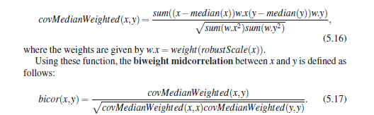
*Biweight midcorrelation (bicor)
A robust alternative to Pearson correlation.
Definition based on median instead of mean.
Assign weights to observations, values close to median receive large weights.
Robust to outliers.
Book: "Data Analysis and Regression: A Second Course in Statistics", Mosteller and Tukey, Addison-Wesley, 1977, pp. 203-209
Langfelder et al 2012: Fast R Functions For Robust Correlations And Hierarchical Clustering. J Stat Softw 2012, 46(i11):1–17.

Slide 22
Comparison of co-expression measures: mutual information, correlation, and model based indices.
Song et al 2012 BMC Bioinformatics;13(1):328. PMID: 23217028
Result: biweight midcorrelation + topological overlap measure work best when it comes to defining co-expression modules

Slide 23
Why soft thresholding as opposed to hard thresholding?
Preserves the continuous information of the co-expression information
Results tend to be more robust with regard to different threshold choices
But hard thresholding has its own advantages:
In particular, graph theoretic algorithms from the computer science community can be applied to the resulting networks

Slide 24
Advantages of soft thresholding with the power function
Robustness: Network results are highly robust with respect to the choice of the power β (Zhang et al 2005)
Calibration of different networks becomes straightforward, which facilitates consensus module analysis
Module preservation statistics are particularly sensitive for measuring connectivity preservation in weighted networks
Math reason: Geometric Interpretation of Gene Co-Expression Network Analysis. PloS Computational Biology. 4(8): e1000117

Slide 25
Questions: How should we choose the power beta or a hard threshold? Or more generally the parameters of an adjacency function? IDEA: use properties of the connectivity distribution

Slide 26
Generalized Connectivity
Gene connectivity = row sum of the adjacency matrix
For unweighted networks=number of direct neighbors
For weighted networks= sum of connection strengths to other nodes

Slide 27
Approximate scale free topology is a fundamental property of such networks (L. Barabasi et al)
It entails the presence of hub nodes that are connected to a large number of other nodes
Such networks are robust with respect to the random deletion of nodes but are sensitive to the targeted attack on hub nodes
It has been demonstrated that metabolic networks exhibit scale free topology at least approximately.

Slide 28
P(k) vs k in scale free networks
P(k)
Scale Free Topology refers to the frequency distribution of the connectivity k
p(k)=proportion of nodes that have connectivity k
p(k)=Freq(discretize(k,nobins))

Slide 29
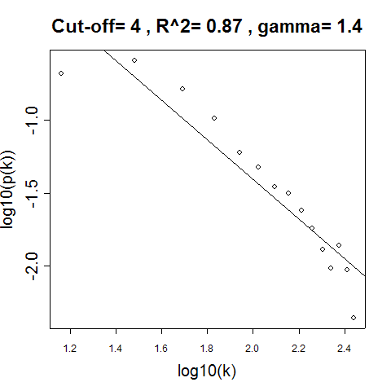
How to check Scale Free Topology?
Idea: Log transformation p(k) and k and look at scatter plots
Linear model fitting R^2 index can be used to quantify goodness of fit

Slide 30
Generalizing the notion of scale free topology
Motivation of generalizations: using weak general assumptions, we have proven that gene co-expression networks satisfy these distributions approximately.
Barabasi (1999)
Csanyi-Szendroi (2004)
Horvath, Dong (2005)

Slide 31
Checking Scale Free Topology in the Yeast Network
Black=Scale Free
Red=Exp. Truncated
Green=Log Log SFT

Slide 32
The scale free topology criterion for choosing the parameter values of an adjacency function.
CONSIDER ONLY THOSE PARAMETER VALUES IN THE ADJACENCY FUNCTION THAT RESULT IN APPROXIMATE SCALE FREE TOPOLOGY, i.e. high scale free topology fitting index R^2
In practice, we use the lowest value where the curve starts to “saturate”
Rationale:
Empirical finding: Many co-expression networks based on expression data from a single tissue exhibit scale free topology
Many other networks e.g. protein-protein interaction networks have been found to exhibit scale free topology
Caveat: When the data contains few very large modules, then the criterion may not apply. In this case, use the default choices.

Slide 33
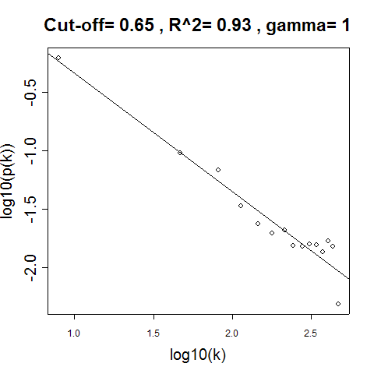
Scale free topology is measured by the linear model fitting index R²
Step AF (tau) Power AF (b)
tau=
b=

Slide 34
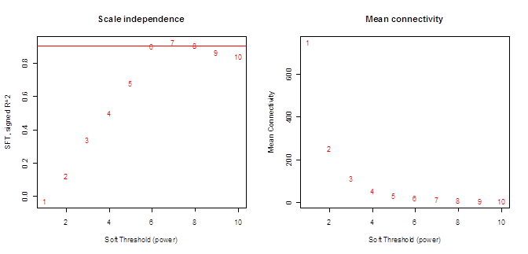
Scale free fitting index (R²) and mean connectivity versus the soft threshold (power beta)
SFT model fitting index R^2 mean connectivity

Slide 35
How to measure interconnectedness in a network? Answers: 1) adjacency matrix 2) topological overlap matrix

Slide 36
Topological overlap matrix and corresponding dissimilarity (Ravasz et al 2002)
k=connectivity=row sum of adjacencies
Generalization to weighted networks is straightforward since the formula is mathematically meaningful even if the adjacencies are real numbers in [0,1] (Zhang et al 2005 SAGMB)
Generalized topological overlap (Yip et al (2007) BMC Bioinformatics)

Slide 37
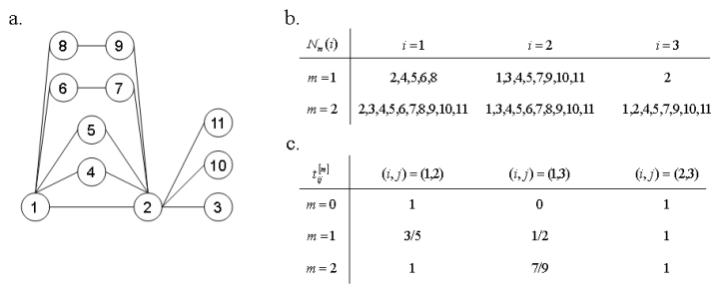
Set interpretation of the topological overlap matrix
N₁(i) denotes the set of 1-step (i.e. direct) neighbors of node i
| | measures the cardinality
Adding 1-a(i,j) to the denominator prevents it from becoming 0.

Slide 38
Generalizing the topological overlap matrix to 2 step neighborhoods etc
Simply replace the neighborhoods by 2 step neighborhoods in the following formula
www.genetics.ucla.edu/labs/horvath/GTOM
Yip A et al (2007) BMC Bioinformatics 2007, 8:22

Slide 39
How to detect network modules (clusters) ?

Slide 40
Module Definition
We often use average linkage hierarchical clustering coupled with the topological overlap dissimilarity measure.
Based on the resulting cluster tree, we define modules as branches
Modules are either labeled by integers (1,2,3…) or equivalently by colors (turquoise, blue, brown, etc)

Slide 41
Defining clusters from a hierarchical cluster tree: the Dynamic Tree Cut library for R.
Langfelder P, Zhang B et al (2007) Bioinformatics 2008 24(5):719-720

Slide 42
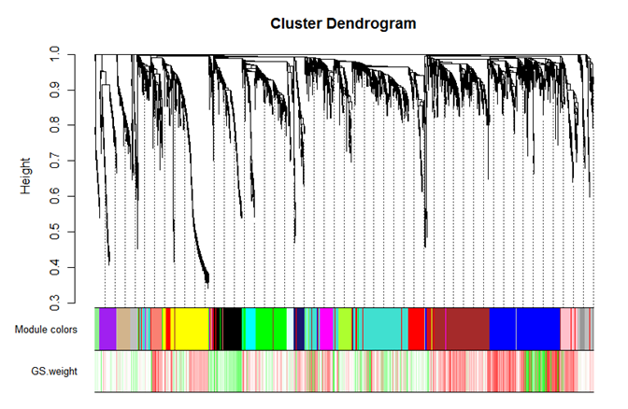
Example:
From: Ghazalpour et al (2006), PLoS Genetics Volume 2 Issue 8

Slide 43
Two types of branch cutting methods
Constant height (static) cut
cutreeStatic(dendro,cutHeight,minsize)
based on R function cutree
Adaptive (dynamic) cut
cutreeDynamic(dendro, ...)
Getting more information about the dynamic tree cut:
library(dynamicTreeCut)
help(cutreeDynamic)
More details: www.genetics.ucla.edu/labs/horvath/CoexpressionNetwork/BranchCutting/

Slide 44
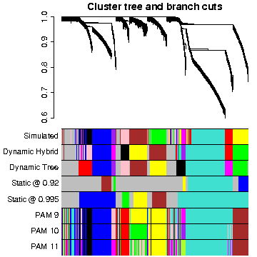
How to cut branches off a tree?
Module=branch of a cluster tree
Dynamic hybrid branch cutting method combines
advantages of hierarchical clustering and partitioning aruond medoid clustering

Slide 45
Summary
Static tree cut: simple, but requires careful choice of height and not suitable for complicated dendrograms with nested clusters.
Dynamic tree cut: Two versions, Tree and Hybrid
Both look at the shape of the branches on the dendrogram, height and size information. Small clusters can be merged with neighboring large clusters
Hybrid combines dendrogram cutting and PAM and retains advantages of both
no need to specify number of cluster
robustness

Slide 46
Summary (cont’d)
Advantages of Dynamic Tree Cut methods over the constant height one:
More flexible: can deal with complicated dendrograms
Better outlier detection (Hybrid best, Tree not as good)
Suitable for automation (Tree possibly somewhat better because of fewer parameter settings)
Less sensitive to small changes in parameters, but user beware: defaults aren’t always appropriate.

Slide 47
How to visualize networks? Answer: 1) Topological overlap matrix plot aka. connectivity plot 2) Multidimensional scaling 3) heatmaps of modules 4) external software: ViSANT,Cytoscape etc

Slide 48
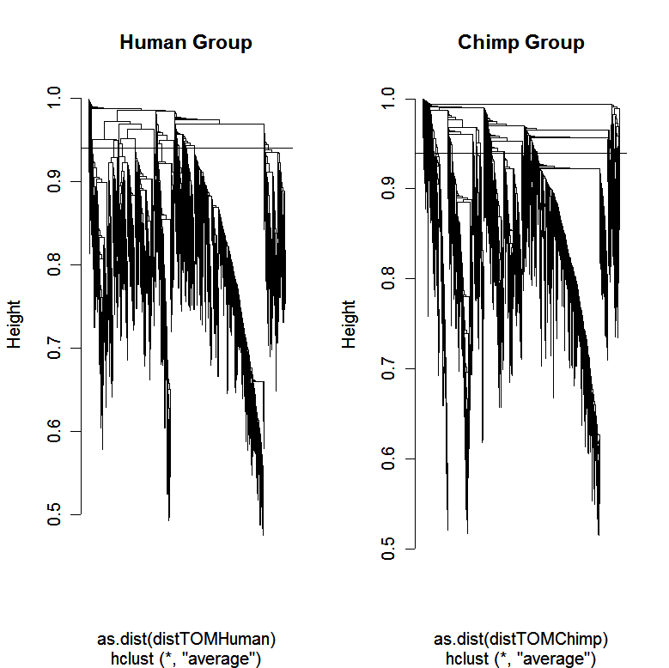
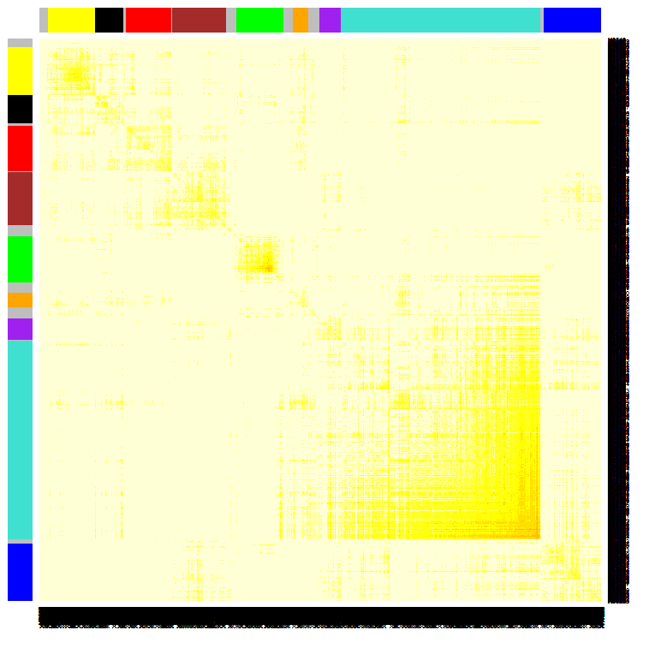

Using the topological overlap matrix (TOM) to cluster genes
Here modules correspond to branches of the dendrogram
TOM plot
Genes correspond to rows and columns
TOM matrix
Hierarchical clustering
dendrogram
Module:
Correspond
to branches

Slide 49
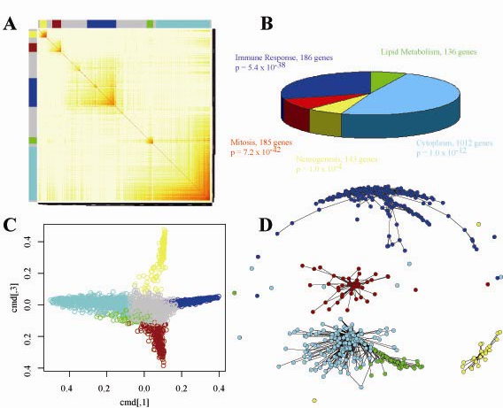
Different Ways of Depicting Gene Modules
Topological Overlap Plot Gene Functions
Multi Dimensional Scaling Traditional View
1) Rows and columns
correspond to genes
2) Red boxes along
diagonal are modules
3) Color bands=modules
Idea:
Use network distance in MDS

Slide 50
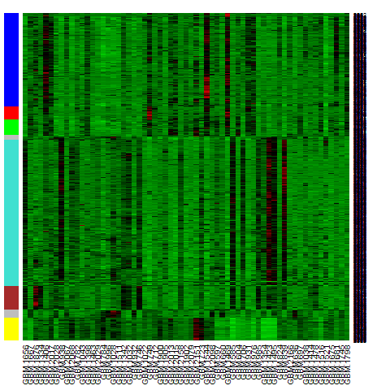
Heatmap view of module
Columns= tissue samples
Rows=Genes
Color band indicates
module membership
Message: characteristic vertical bands indicate
tight co-expression of module genes

Slide 51
Question: How does one summarize the expression profiles in a module? Answer: This has been solved. Math answer: module eigengene = first principal component Network answer: the most highly connected intramodular hub gene Both turn out to be equivalent

Slide 52
Module Eigengene= measure of over-expression=average redness
Rows,=genes, Columns=microarray
The brown module eigengenes across samples

Slide 53
Using the singular value decomposition to define (module) eigengenes

Slide 54
Module eigengenes are very useful
1) They allow one to relate modules to each other
Allows one to determine whether modules should be merged
Or to define eigengene networks
2) They allow one to relate modules to clinical traits and SNPs
-> avoids multiple comparison problem
3) They allow one to define a measure of module membership: kME=cor(x,ME)

Slide 55
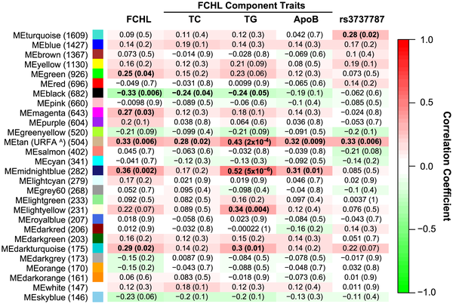
Eigengenes correlated with lipid traits and a disease related SNP Plaisier, Pajukanta 2009 Plos Genet
SNP

Slide 56
Module eigengenes can be used to determine whether 2 modules
are correlated. If correlation of MEs is high-> consider merging.
Eigengene networks
Langfelder, Horvath (2007) BMC Systems Biology

Slide 57
Module detection in very large data sets
R function blockwiseModules (in WGCNA library) implements 3 steps:
Variant of k-means to cluster variables into blocks
Hierarchical clustering and branch cutting in each block
Merge modules across blocks (based on correlations between module eigengenes)
Works for hundreds of thousands of variables

Slide 58
How to relate modules to external data?

Slide 59
Clinical trait (e.g. case-control status) gives rise to a gene significance measure
Abstract definition of a gene significance measure
GS(i) is non-negative,
the bigger, the more *biologically* significant for the i-th gene
Equivalent definitions
GS.ClinicalTrait(i) = |cor(x(i),ClinicalTrait)| where x(i) is the gene expression profile of the i-th gene
GS(i)=|T-test(i)| of differential expression between groups defined by the trait
GS(i)=-log(p-value)

Slide 60
A SNP marker naturally gives rise to a measure of gene significance
GS.SNP(i) = |cor(x(i), SNP)|.
Additive SNP marker coding: AA->2, AB->1, BB->0
Absolute value of the correlation ensures that this is equivalent to AA->0, AB->1, BB->2
Dominant or recessive coding may be more appropriate in some situations
Conceptually related to a LOD score at the SNP marker for the i-th gene expression trait

Slide 61
A gene significance naturally gives rise to a module significance measure
Define module significance as mean gene significance
Often highly related to the correlation between module eigengene and trait

Slide 62
Important Task in Many Genomic Applications: Given a network (pathway) of interacting genes how to find the central players?

Slide 63
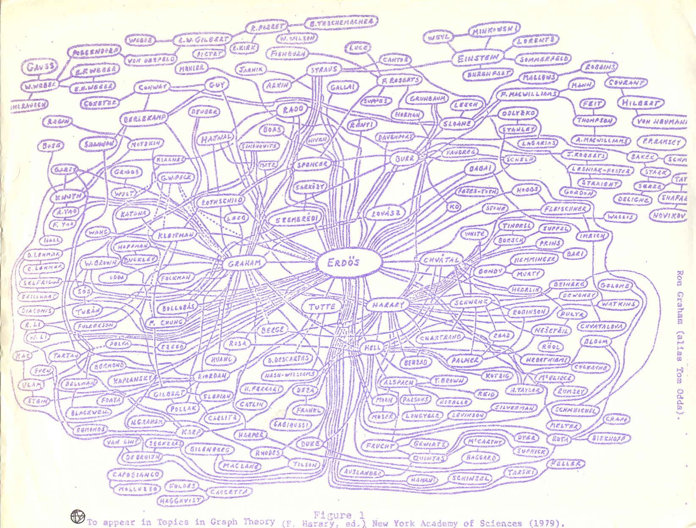
Which of the following mathematicians had the biggest influence on others?
Connectivity can be an important variable for identifying important nodes

Slide 64
Flight connections and hub airports
The nodes with the largest number of links (connections) are most important!
**Slide courtesy of AL Barabasi

Slide 65
Hub genes with respect to the whole network are often uninteresting (especially in coexpression networks)…
but genes with high connectivity in interesting modules can be very interesting.
Citations: 1) PNAS 2006 PMC1635024 2) Langfelder et al (2013) When Is Hub Gene Selection Better than Standard Meta-Analysis? PLoS ONE 8(4): e61505.

Slide 66
Define 2 alternative measures of intramodular connectivity for finding intramodular hubs.

Slide 67
Intramodular connectivity kIN
Row sum across genes inside a given module
Advantages: defined for any network based on adjacency matrix.
Disadvantage: strong depends on module size

Slide 68
Module eigengene based connectivity, kME, also known as module membership measure
kME(i) is simply the correlation between the i-th gene expression profile and the module eigengene.
kME close to 1 means that the gene is a hub gene
Very useful measure for annotating genes with regard to modules.
Can be used to find genes that are members of two or more modules (fuzzy clustering).
Module eigengene can be interpreted as the most highly connected gene.
PloS Computational Biology. 4(8): e1000117. PMID:18704157

Slide 69
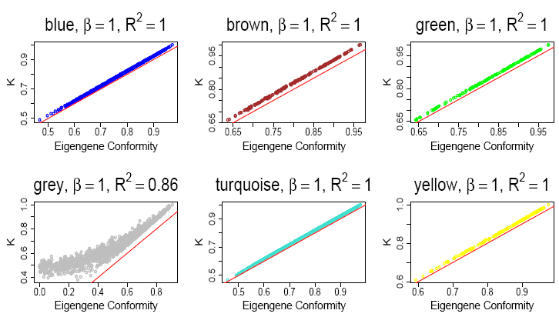

Slide 70
Intramodular hub genes
Defined as genes with high kME (or high kIM)
Single network analysis: Intramodular hubs in biologically interesting modules are often very interesting
Differential network analysis: Genes that are intramodular hubs in one condition but not in another are often very interesting

Slide 71
How to use networks for gene screening?

Slide 72
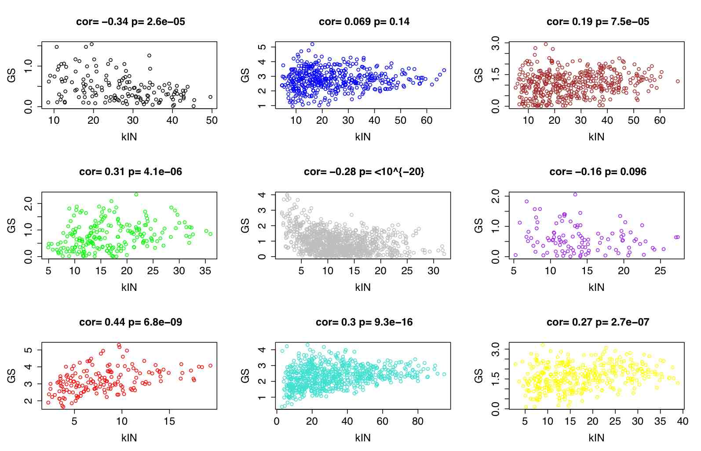
Gene significance versus intramodular connectivity kIN

Slide 73
Intramodular connectivity versus gene significance GS
Note the relatively high correlation between gene significance and intramodular connectivity in some modules
In practice, a combination of GS and intramodular connectivity is used to select important hub genes.
Module eigengene turns out to be the most highly connected gene (under mild assumptions)

Slide 74
What is weighted gene co-expression network analysis?

Slide 75
Construct a network
Rationale: make use of interaction patterns between genes
Identify modules
Rationale: module (pathway) based analysis
Relate modules to external information
Array Information: Clinical data, SNPs, proteomics
Gene Information: gene ontology, EASE, IPA
Rationale: find biologically interesting modules
Study Module Preservation across different data
Rationale:
Same data: to check robustness of module definition
Different data: to find interesting modules.
Find the key drivers in interesting modules
Tools: intramodular connectivity, causality testing
Rationale: experimental validation, therapeutics, biomarkers

Slide 76
What is different from other analyses?
Emphasis on modules instead of individual genes
Greatly alleviates the problem of multiple comparisons
Use of intramodular connectivity to find key drivers
Quantifies module membership
Module definition is only based on interconnectedness
No prior pathway information is used for module definition
Two module (eigengenes) can be highly correlated
Emphasis on a unified approach for relating variables
Default: correlation (biweight midcorrelation)
Rationale:
puts different data sets on the same mathematical footing
Technical Details: soft thresholding with the power adjacency function, topological overlap matrix to measure interconnectedness

Slide 77
Case Study 1: Finding brain cancer genes Horvath S, Zhang B, Carlson M, Lu KV, Zhu S, Felciano RM, Laurance MF, Zhao W, Shu, Q, Lee Y, Scheck AC, Liau LM, Wu H, Geschwind DH, Febbo PG, Kornblum HI, Cloughesy TF, Nelson SF, Mischel PS (2006) "Analysis of Oncogenic Signaling Networks in Glioblastoma Identifies ASPM as a Novel Molecular Target", PNAS | November 14, 2006 | vol. 103 | no. 46

Slide 78
Different Ways of Depicting Gene Modules
Topological Overlap Plot Gene Functions
Multi Dimensional Scaling Traditional View
1) Rows and columns
correspond to genes
2) Red boxes along
diagonal are modules
3) Color bands=modules

Slide 79
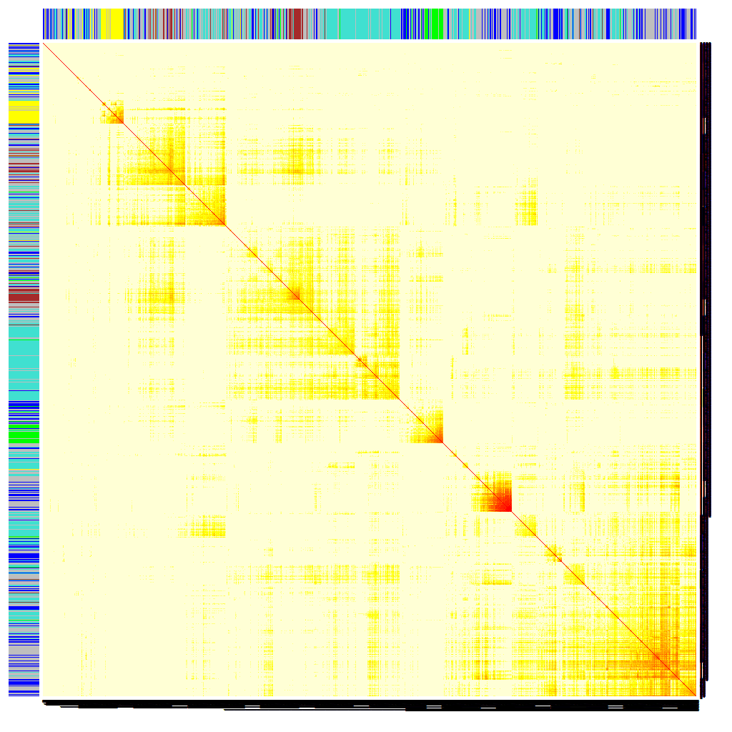
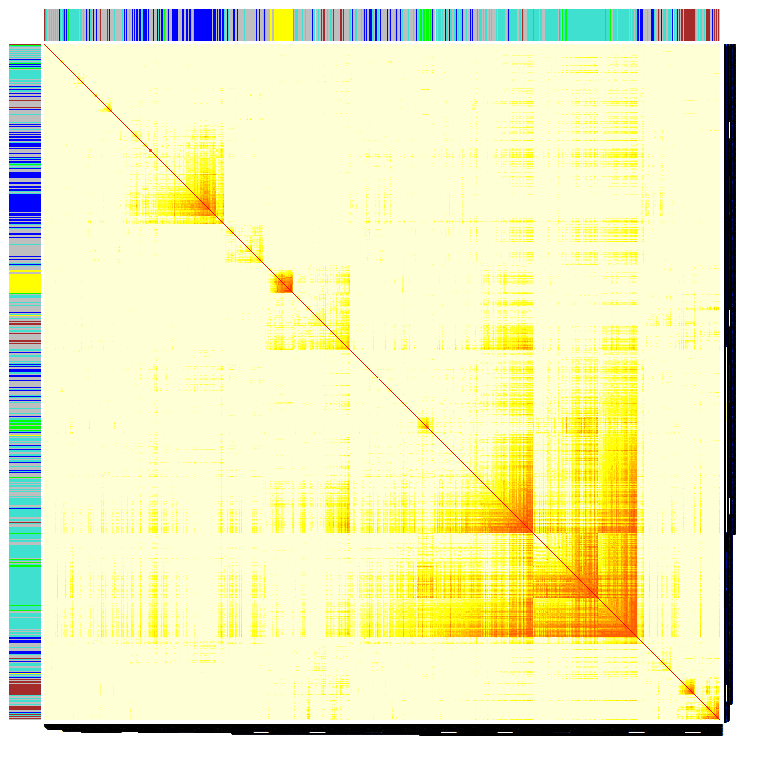
Comparing the Module Structure in Cancer and Normal tissues
55 Brain Tumors
VALIDATION DATA: 65 Brain Tumors
Messages:
1)Cancer modules can be
independently validated
2) Modules in brain cancer tissue
can also be found in normal,
non-brain tissue.
-->
Insights into the biology of cancer
Normal brain (adult + fetal)
Normal non-CNS tissues

Slide 80
Mean Prognostic Significance of Module Genes
Message: Focus the attention on the brown module genes

Slide 81
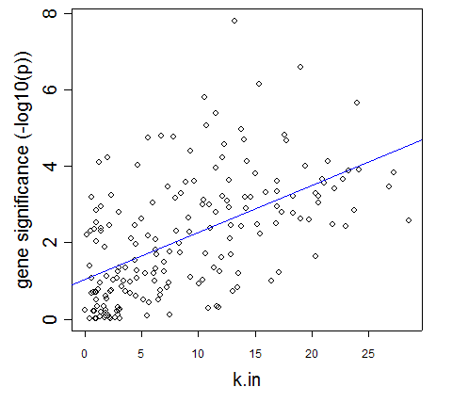
Module hub genes predict cancer survival
Cox model to regress survival on gene expression levels
Defined prognostic significance as –log10(Cox-p-value) the survival association between each gene and glioblastoma patient survival
A module-based measure of gene connectivity significantly and reproducibly identifies the genes that most strongly predict patient survival
Test set – 55 gbms
r = 0.56; p-2.2 x 10⁻¹⁶
Validation set – 65 gbms
r = 0.55; p-2.2 x 10⁻¹⁶

Slide 82
The fact that genes with high intramodular connectivity are more likely to be prognostically significant facilitates a novel screening strategy for finding prognostic genes
Focus on those genes with significant Cox regression p-value AND high intramodular connectivity.
It is essential to to take a module centric view: focus on intramodular connectivity of disease related module
Validation success rate= proportion of genes with independent test set Cox regression p-value<0.05.
Validation success rate of network based screening approach (68%)
Standard approach involving top 300 most significant genes: 26%

Slide 83
Validation success rate of gene expressions in independent data
300 most significant genes Network based screening
(Cox p-value<1.3*10⁻³) p<0.05 and
high intramodular connectivity
67%
26%

Slide 84
The network-based approach uncovers novel therapeutic targets
Five of the top six hub genes in the mitosis module are already known cancer targets: topoisomerase II,
Rac1, TPX2, EZH2 and KIF14.
We hypothesized that the 6-th gene ASPM gene is novel therapeutic target. ASPM encodes the human ortholog of a drosophila mitotic spindle protein.
Biological validation: siRNA mediated inhibition of ASPM

Slide 85
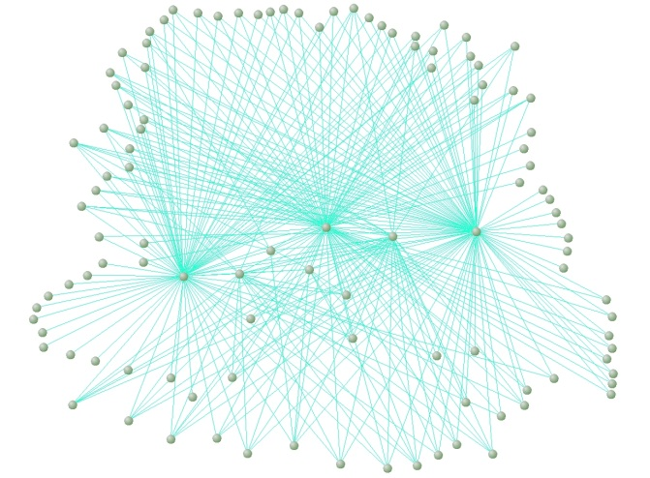
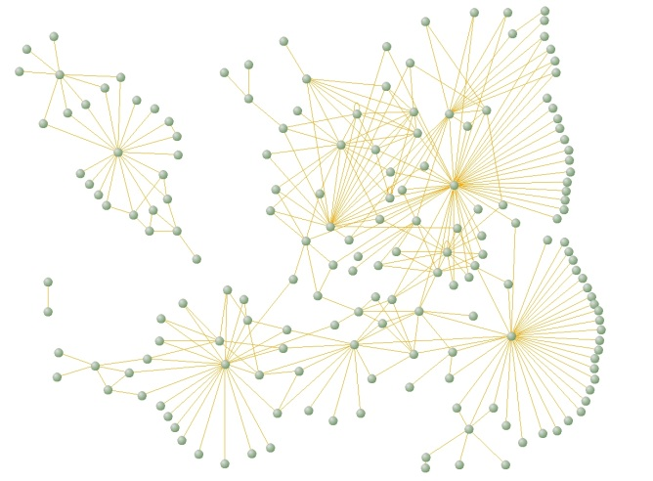
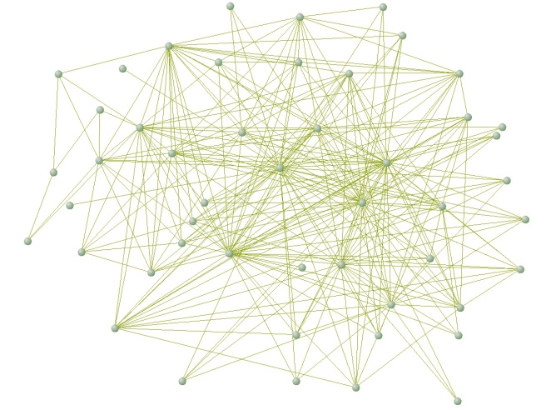

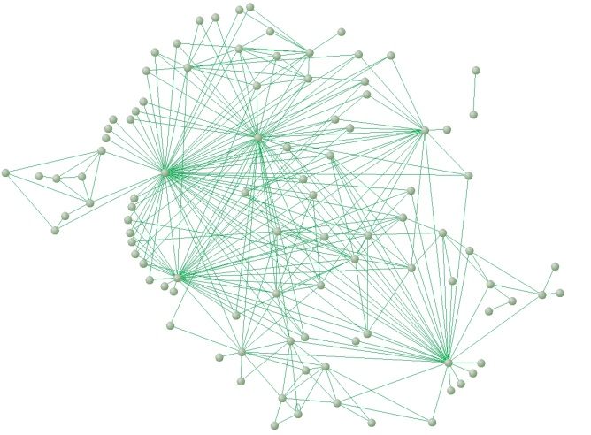
Case Study 2
MC Oldham, S Horvath, DH Geschwind (2006) Conservation and evolution of gene co-expression networks in human and chimpanzee brain. PNAS

Slide 86
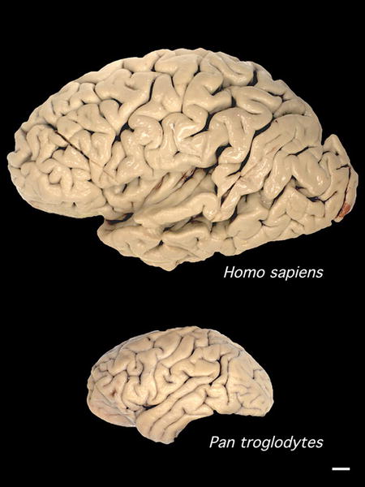
What changed?
Despite pronounced phenotypic differences, genomic similarity is ~96% (including single-base substitutions and indels)¹
Similarity is even higher in protein-coding regions
¹ Cheng, Z. et al. Nature 437, 88-93 (2005)
Image courtesy of Todd Preuss (Yerkes National Primate Research Center)

Slide 87
Assessing the contribution of regulatory changes to human evolution
Hypothesis: Changes in the regulation of gene expression were critical during recent human evolution (King & Wilson, 1975)
Microarrays are ideally suited to test this hypothesis by comparing expression levels for thousands of genes simultaneously

Slide 88
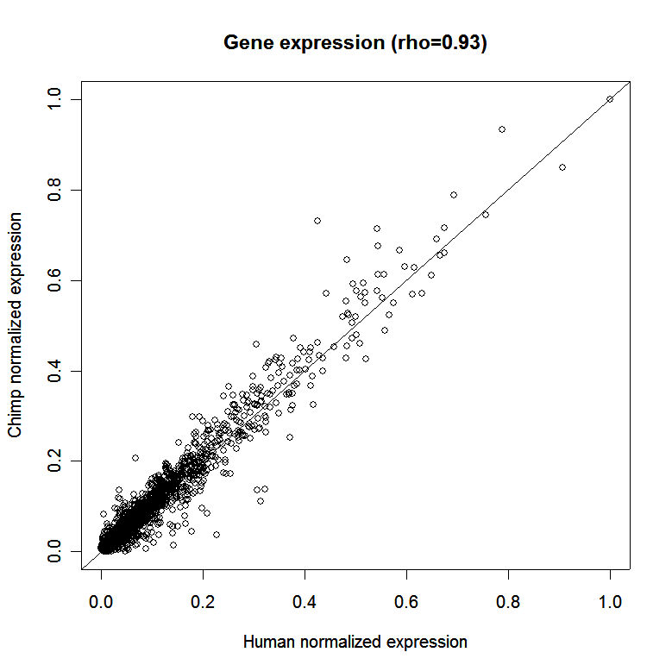
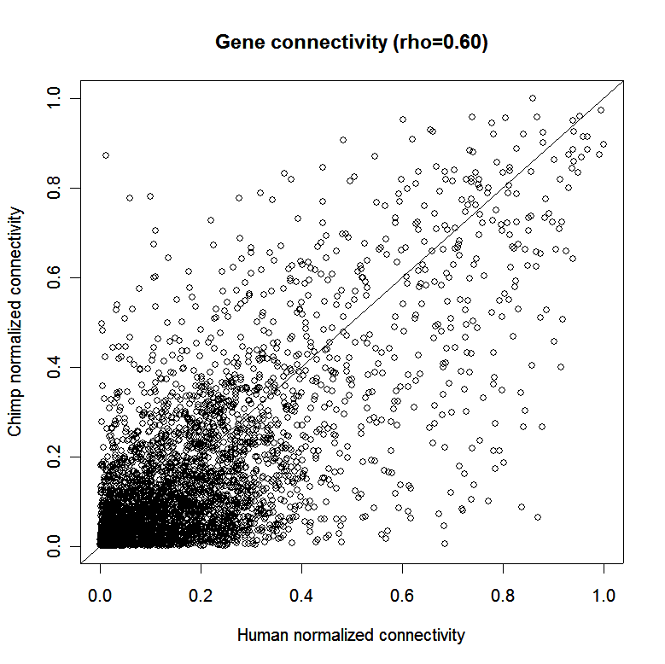
Gene expression is more strongly preserved than gene connectivity
Chimp Chimp
Expression
Cor=0.93 Cor=0.60
Human Expression Human Connectivity
Hypothesis: molecular wiring makes us human
Raw data from Khaitovich et al., 2004
Mike Oldham
Notes:
Based on top 4000 genes sorted by variance across six brain regions in human and chimp; Spearman’s rank correlation.

Slide 89
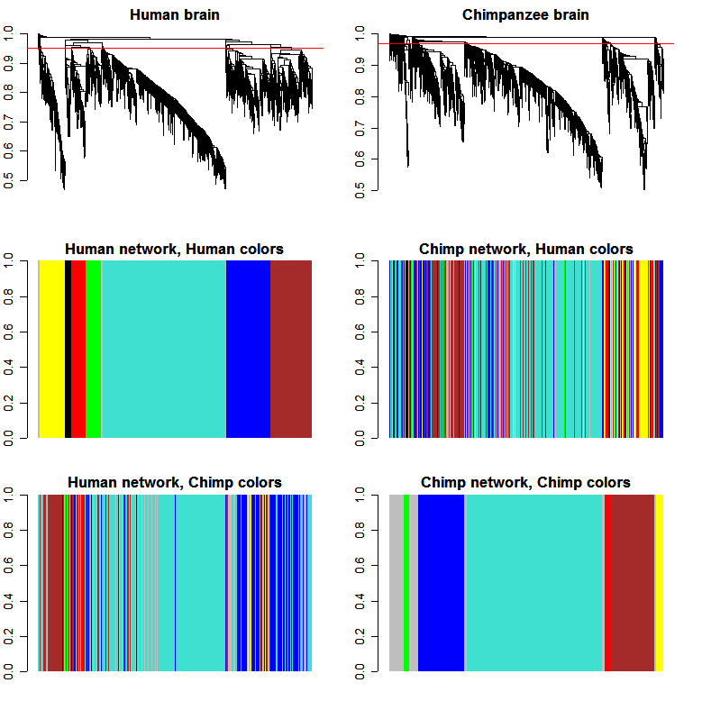
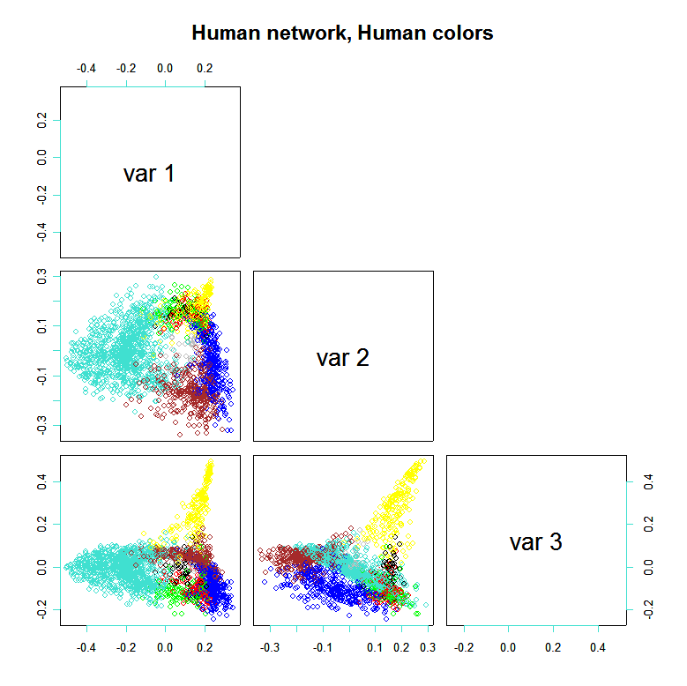
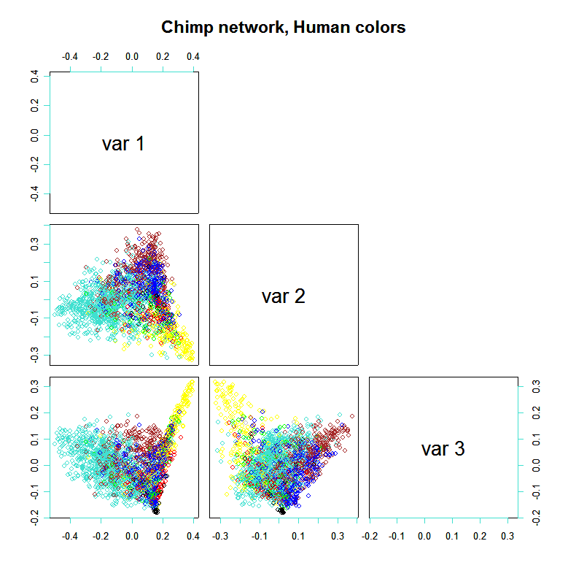
A
B
Human
Chimp
Notes:
Figure 3. Identification of network modules in the brain based upon patterns of gene connectivity. Modules were defined via hierarchical clustering of a topological overlap matrix (TOM) for humans (A) and chimpanzees (B). The red horizontal line in the top panel indicates the height at which the dendrogram was “cut” to produce modules (human=0.95; chimpanzee=0.97). Colors were assigned to the human modules (C) on the basis of their size (number of genes); genes in the chimpanzee network are colored according to their human module color (D). Multidimensional scaling (MDS) plots were created using a measure of dissimilarity derived from the topological overlap matrix as a distance metric for humans (E) and chimpanzees (F). The largest (turquoise) module is cohesive and well preserved between humans and chimpanzees. The yellow module, which is the most cohesive in both species, is also well preserved. The smaller black and red modules are less cohesive but retain some preservation. The brown and blue modules appear fragmented in chimpanzee, and preservation of the green module is essentially absent.

Slide 90
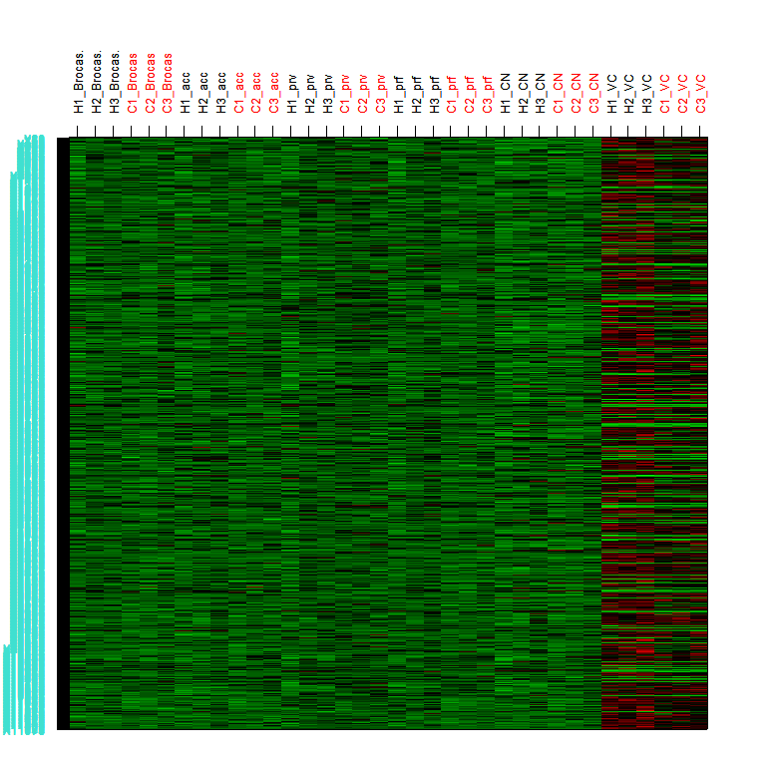
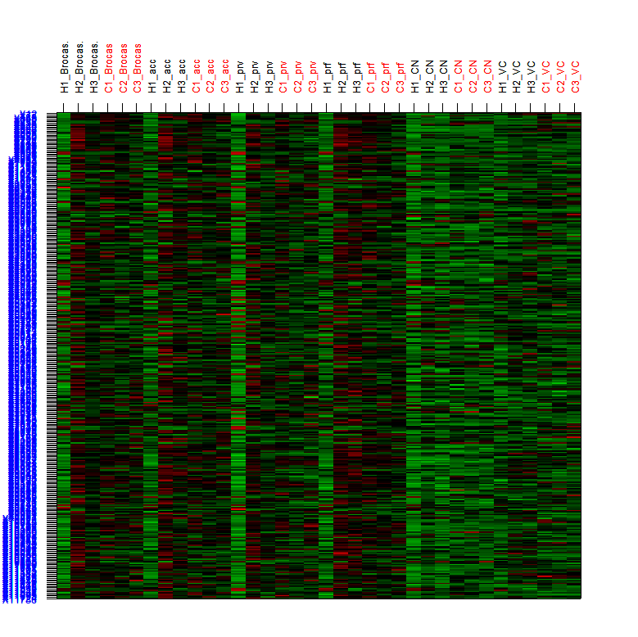
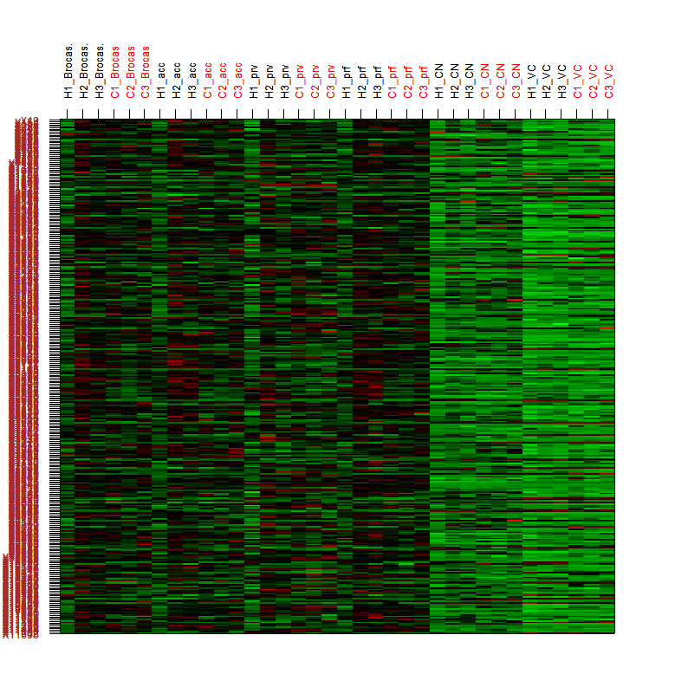
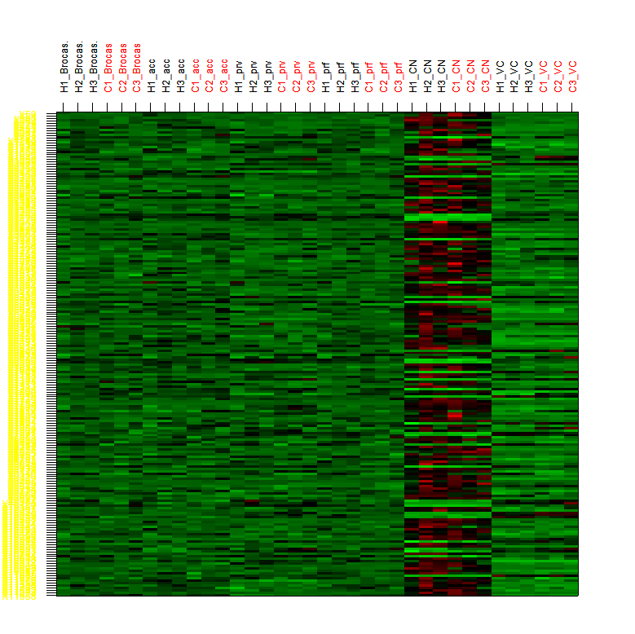
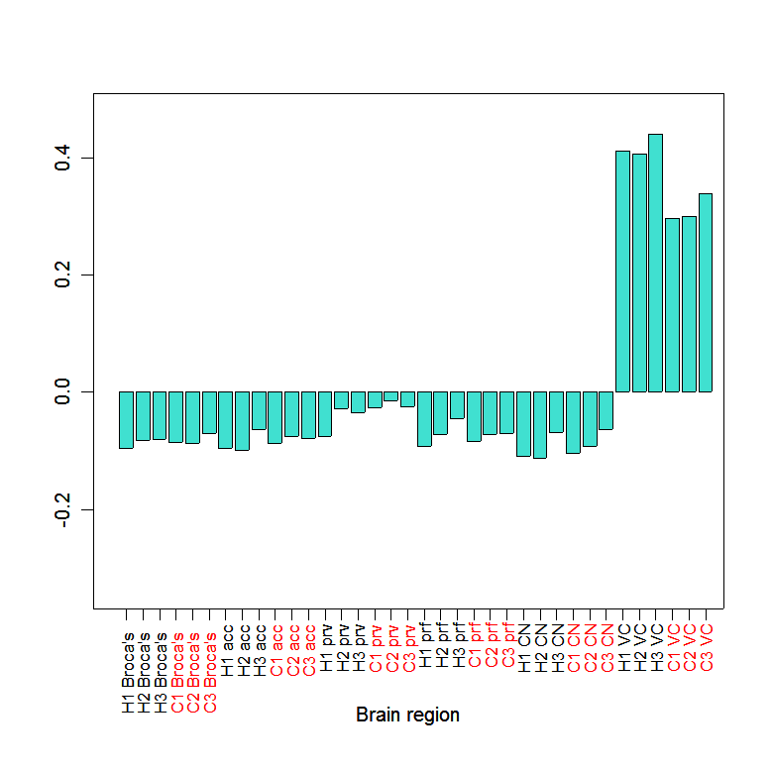
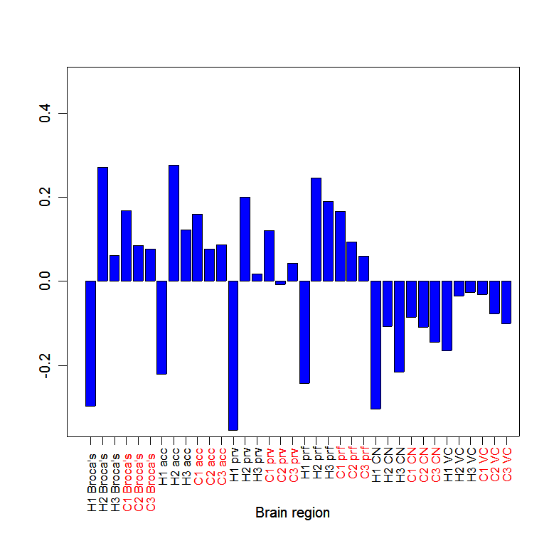
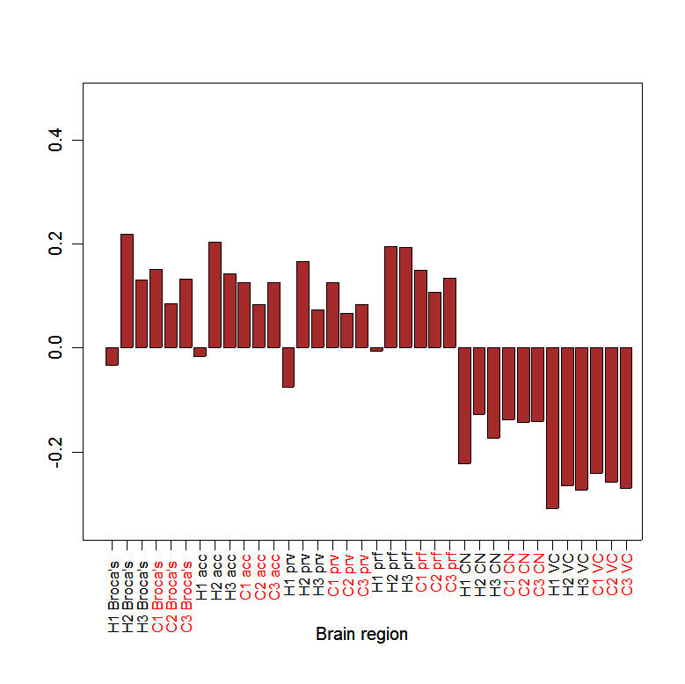
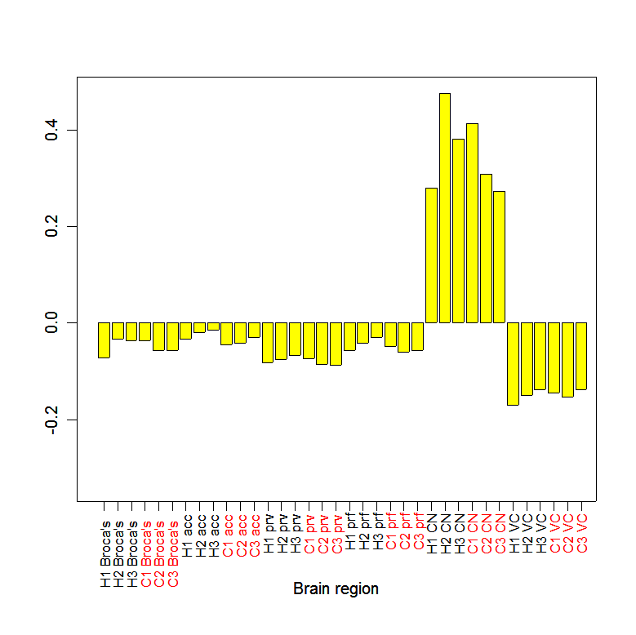
p = 1.33x10⁻⁴
p = 8.93x10⁻⁴
p = 1.35x10⁻⁶
p = 1.33x10⁻⁴
Notes:
Figure 4.

Slide 91
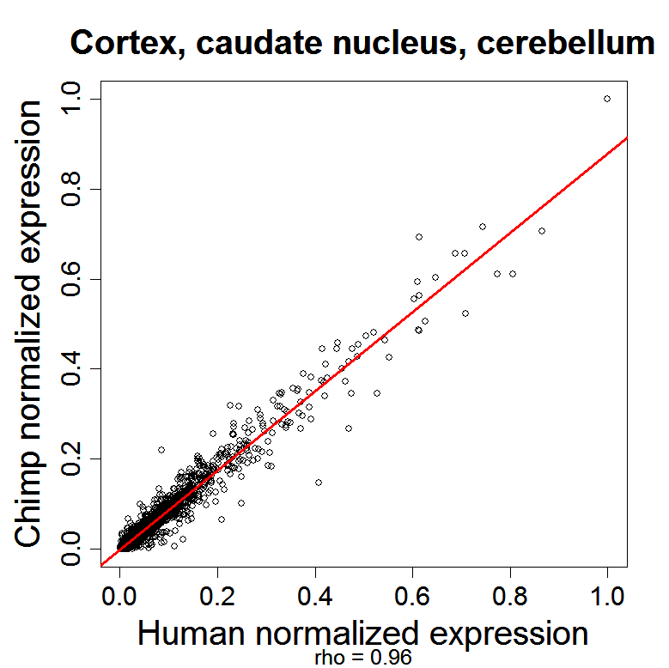
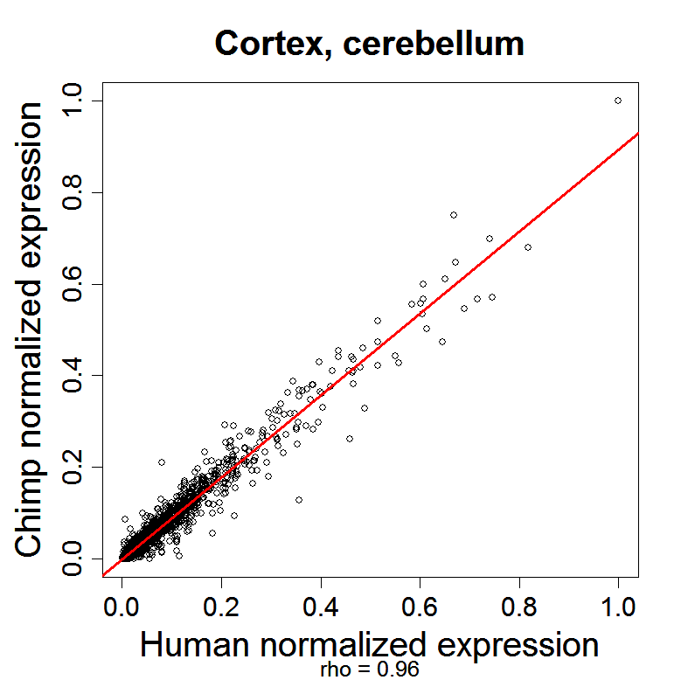
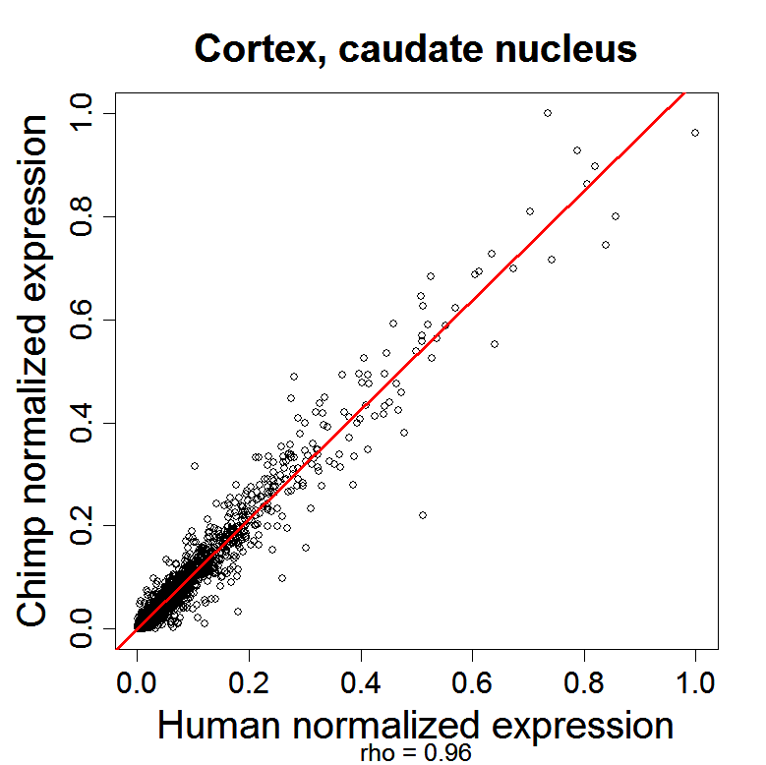
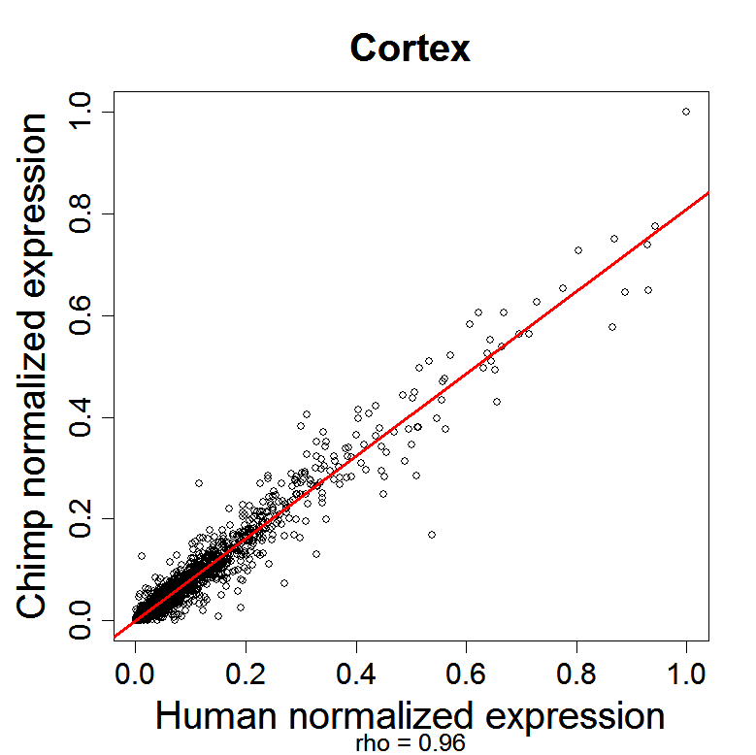
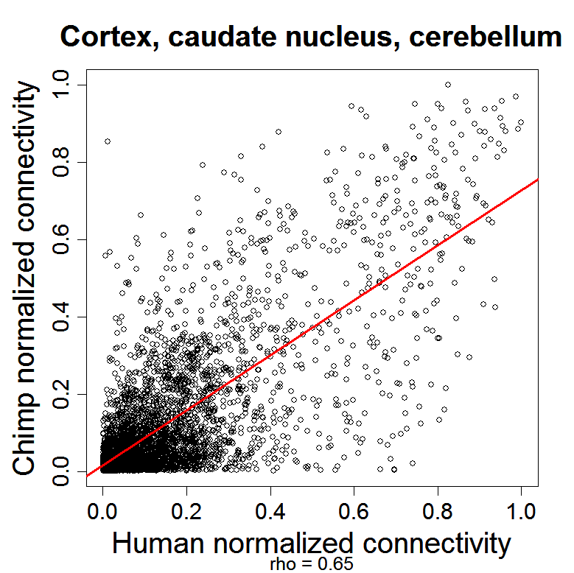



Connectivity diverges across brain regions whereas expression does not

Slide 92
Conclusions: chimp/human
Gene expression is highly preserved across species brains
Gene co-expression is less preserved
Some modules are highly preserved
Gene modules correspond roughly to brain architecture
Species-specific hubs can be validated in silico using sequence comparisons

Slide 93
A short methodological summary of the publications.
WGCNA methods
Horvath S (2011) Weighted Network Analysis. Applications in Genomics and Systems Biology. Springer Book. ISBN: 978-1-4419-8818-8
Zhang B, Horvath S (2005) "A General Framework for Weighted Gene Co-Expression Network Analysis", Statistical Applications in Genetics and Molecular Biology: Vol. 4: No. 1, Article 17
Langfelder P, Horvath S (2008) WGCNA: an R package for Weighted Correlation Network Analysis. BMC Bioinformatics. 2008 Dec 29;9(1):559. PMID: 19114008 PMCID: PMC2631488
Langfelder P et al (2011) Is my network module preserved and reproducible? PloS Comp Biol. 7(1): e1001057. PMID: 21283776
Math and WGCNA:
Horvath S, Dong J (2008) Geometric Interpretation of Gene Co-Expression Network Analysis. PloS Computational Biology. 4(8): e1000117. PMID: 18704157
Empirical evaluation of WGCNA
Langfelder P, et al (2013) When Is Hub Gene Selection Better than Standard Meta-Analysis? PLoS ONE 8(4): e61505.
Song L, Langfelder P, Horvath S. (2012) Comparison of co-expression measures: mutual information, correlation, and model based indices.BMC Bioinformatics;13(1):328. PMID: 23217028
What is the topological overlap measure? Empirical studies of the robustness of the topological overlap measure:
Yip A, Horvath S (2007) Gene network interconnectedness and the generalized topological overlap measure. BMC Bioinformatics 8:22
Dynamic branch cutting:
Langfelder P, Zhang B, Horvath S (2008) Defining clusters from a hierarchical cluster tree: the Dynamic Tree Cut package for R. Bioinformatics.;24(5):719-20. PMID: 18024473
Gene screening based on intramodular connectivity identifies brain cancer genes that validate.
Horvath S, Zhang B, Carlson M, Lu KV, Zhu S, Felciano RM, Laurance MF, Zhao W, Shu, Q, Lee Y, Scheck AC, Liau LM, Wu H, Geschwind DH, Febbo PG, Kornblum HI, Cloughesy TF, Nelson SF, Mischel PS (2006) "Analysis of Oncogenic Signaling Networks in Glioblastoma Identifies ASPM as a Novel Molecular Target", PNAS | November 14, 2006 | vol. 103 | no. 46 | 17402-17407
How to integrate SNP markers into weighted gene co-expression network analysis?
Plaisier CL et al Pajukanta P (2009) A systems genetics approach implicates USF1, FADS3 and other causal candidate genes for familial combined hyperlipidemia. PloS Genetics;5(9):e1000642 PMID: 19750004
Differential network analysis:
Fuller TF, Ghazalpour A, Aten JE, Drake TA, Lusis AJ, Horvath S (2007) "Weighted Gene Co-expression Network Analysis Strategies Applied to Mouse Weight", Mammalian Genome.
Neuroscience
Oldham M, Horvath S, Geschwind D (2006) Conservation and Evolution of Gene Co-expression Networks in Human and Chimpanzee Brains. 2006 Nov 21;103(47):17973-8
Oldham MC, Konopka G, Iwamoto K, Langfelder P, Kato T, Horvath S, Geschwind DH (2008) Functional organization of the transcriptome in human brain. Nature Neuroscience. 11(11):1271-82. PMID: 18849986
Voineagu I, Wang X, Johnston P, Lowe JK, Tian Y, Horvath S, Mill J, Cantor R, Blencowe BJ, Geschwind DH (2011) Transcriptomic analysis of autistic brain reveals convergent molecular pathology. Nature. 25;474(7351):380-4 PMID: 21614001

Slide 94
THE END

